Slide 1


LANL Team Update
10/11/2024
Izzy Baumler, Dalton Boeckmann, Morgan Gullo, Jade Waldron

Slide 2
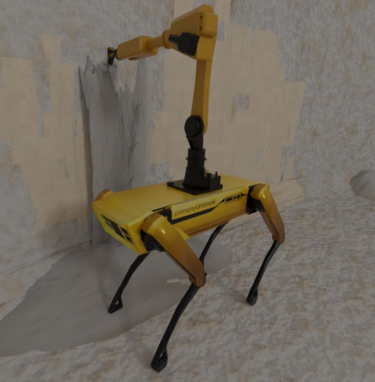
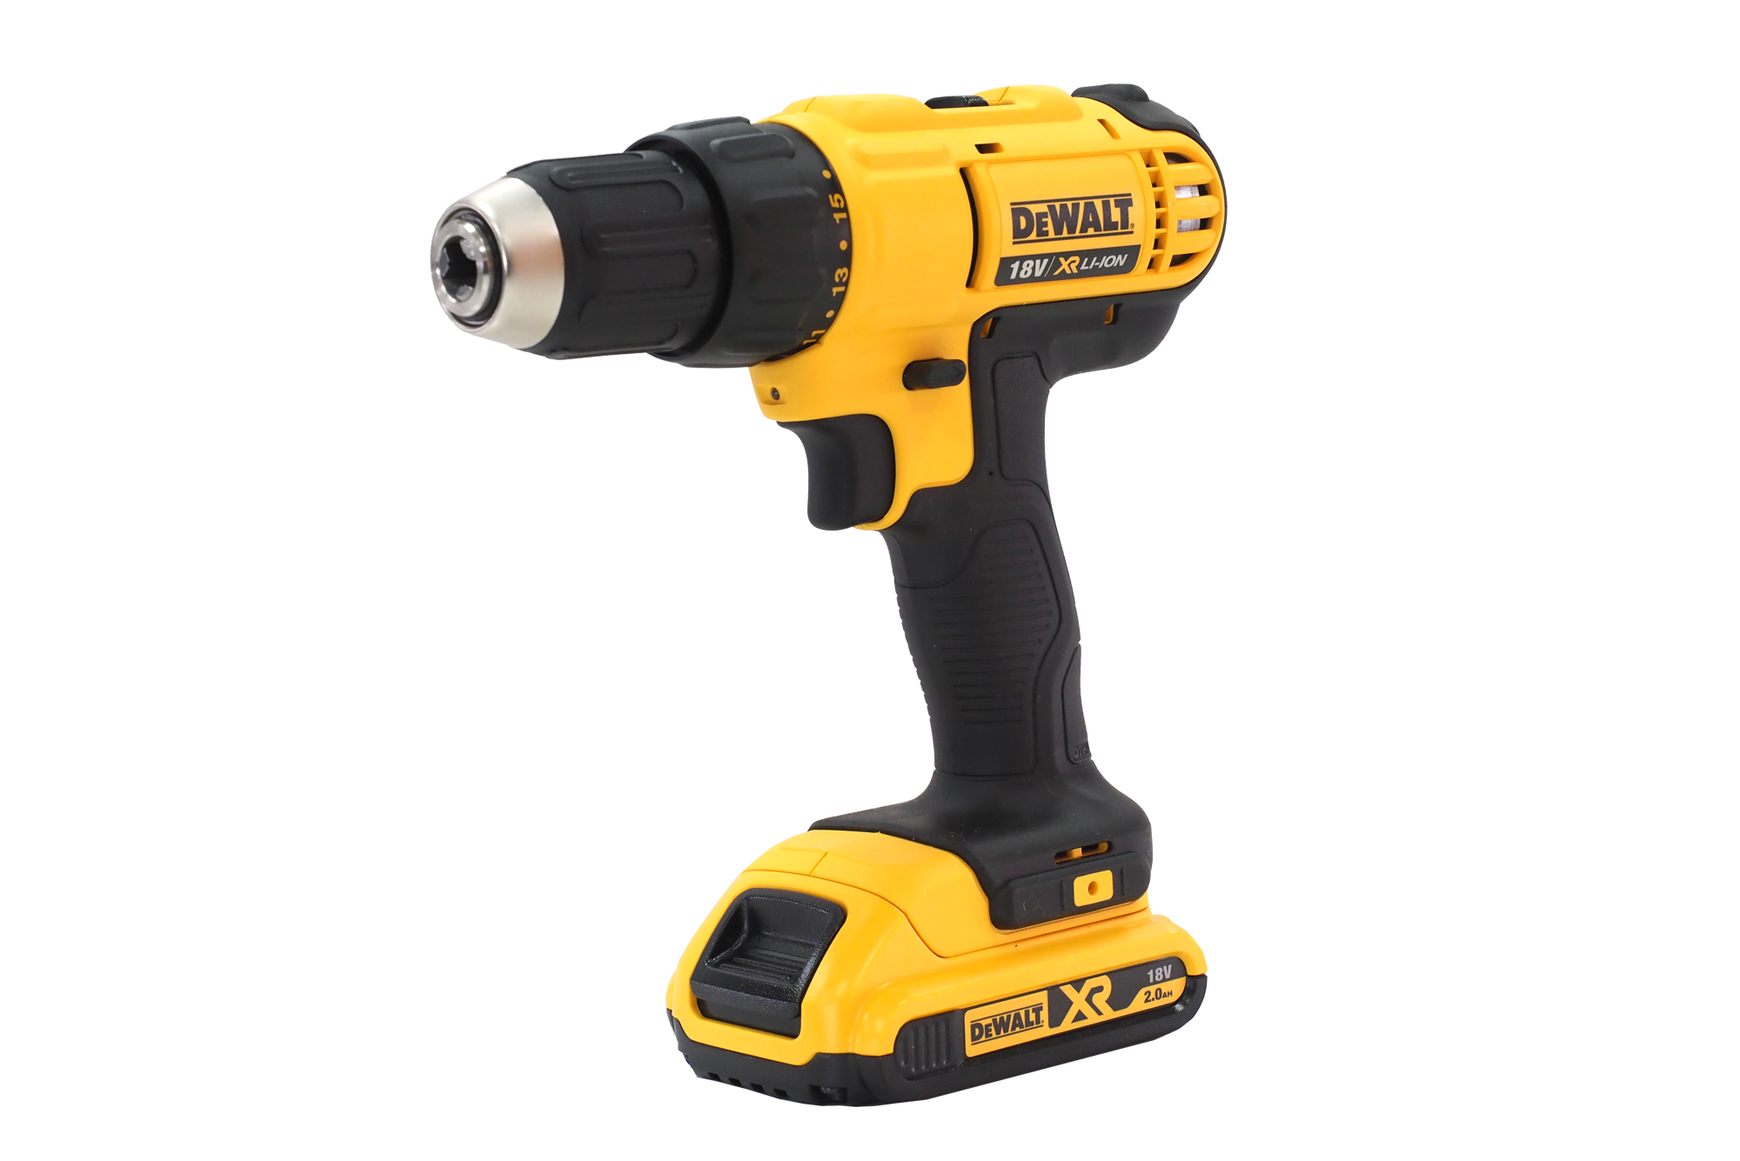

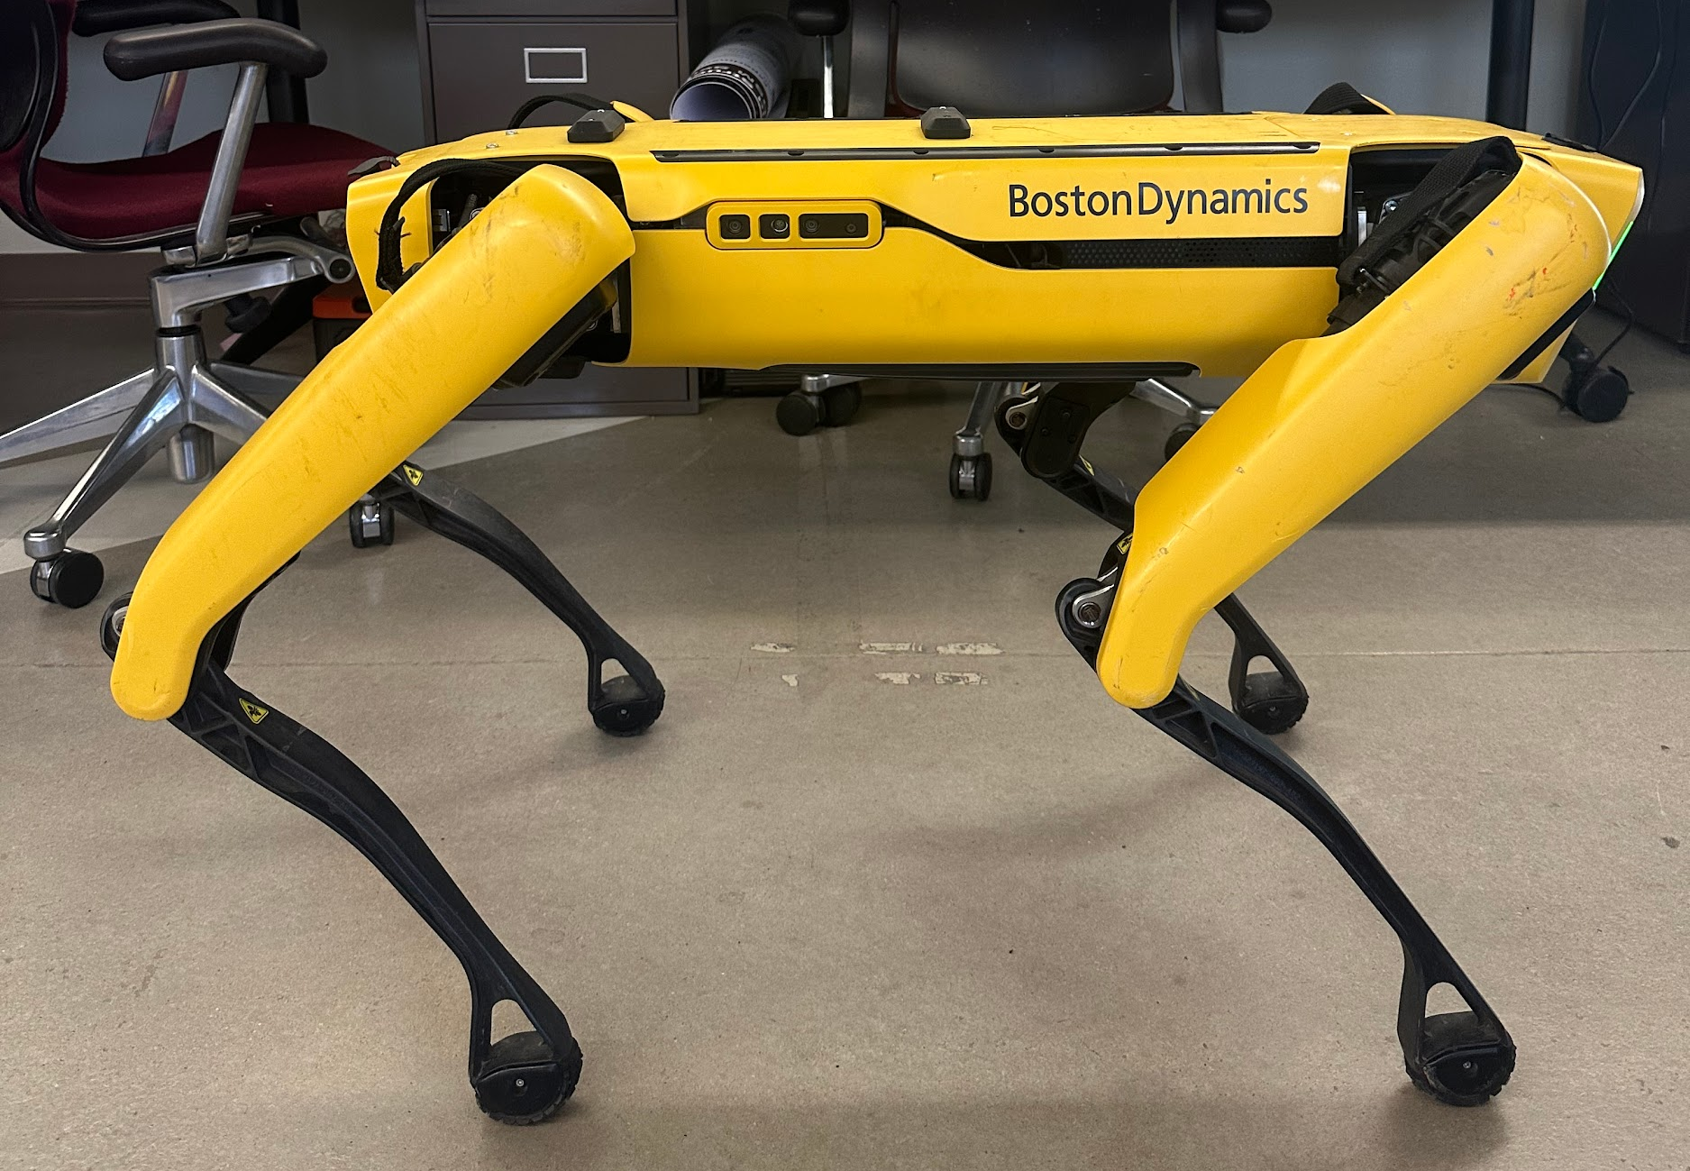
Mission Statement
To design and prototype a semi-autonomous robotic arm that is attached to the Boston Dynamics Spot quadruped robot that can cover a 2 foot radius area.

Slide 3
Design Review 1 Reports
Jade Waldron - Power Tool Attachments for Quadruped Robotic Arm
Izzy Baumler - Integrating Control Systems with Boston Dynamics' Spot Robot
Dalton Boeckmann - Dynamic System Analysis
Morgan Gullo - Passive Force Control and Human Control Interface

Slide 4
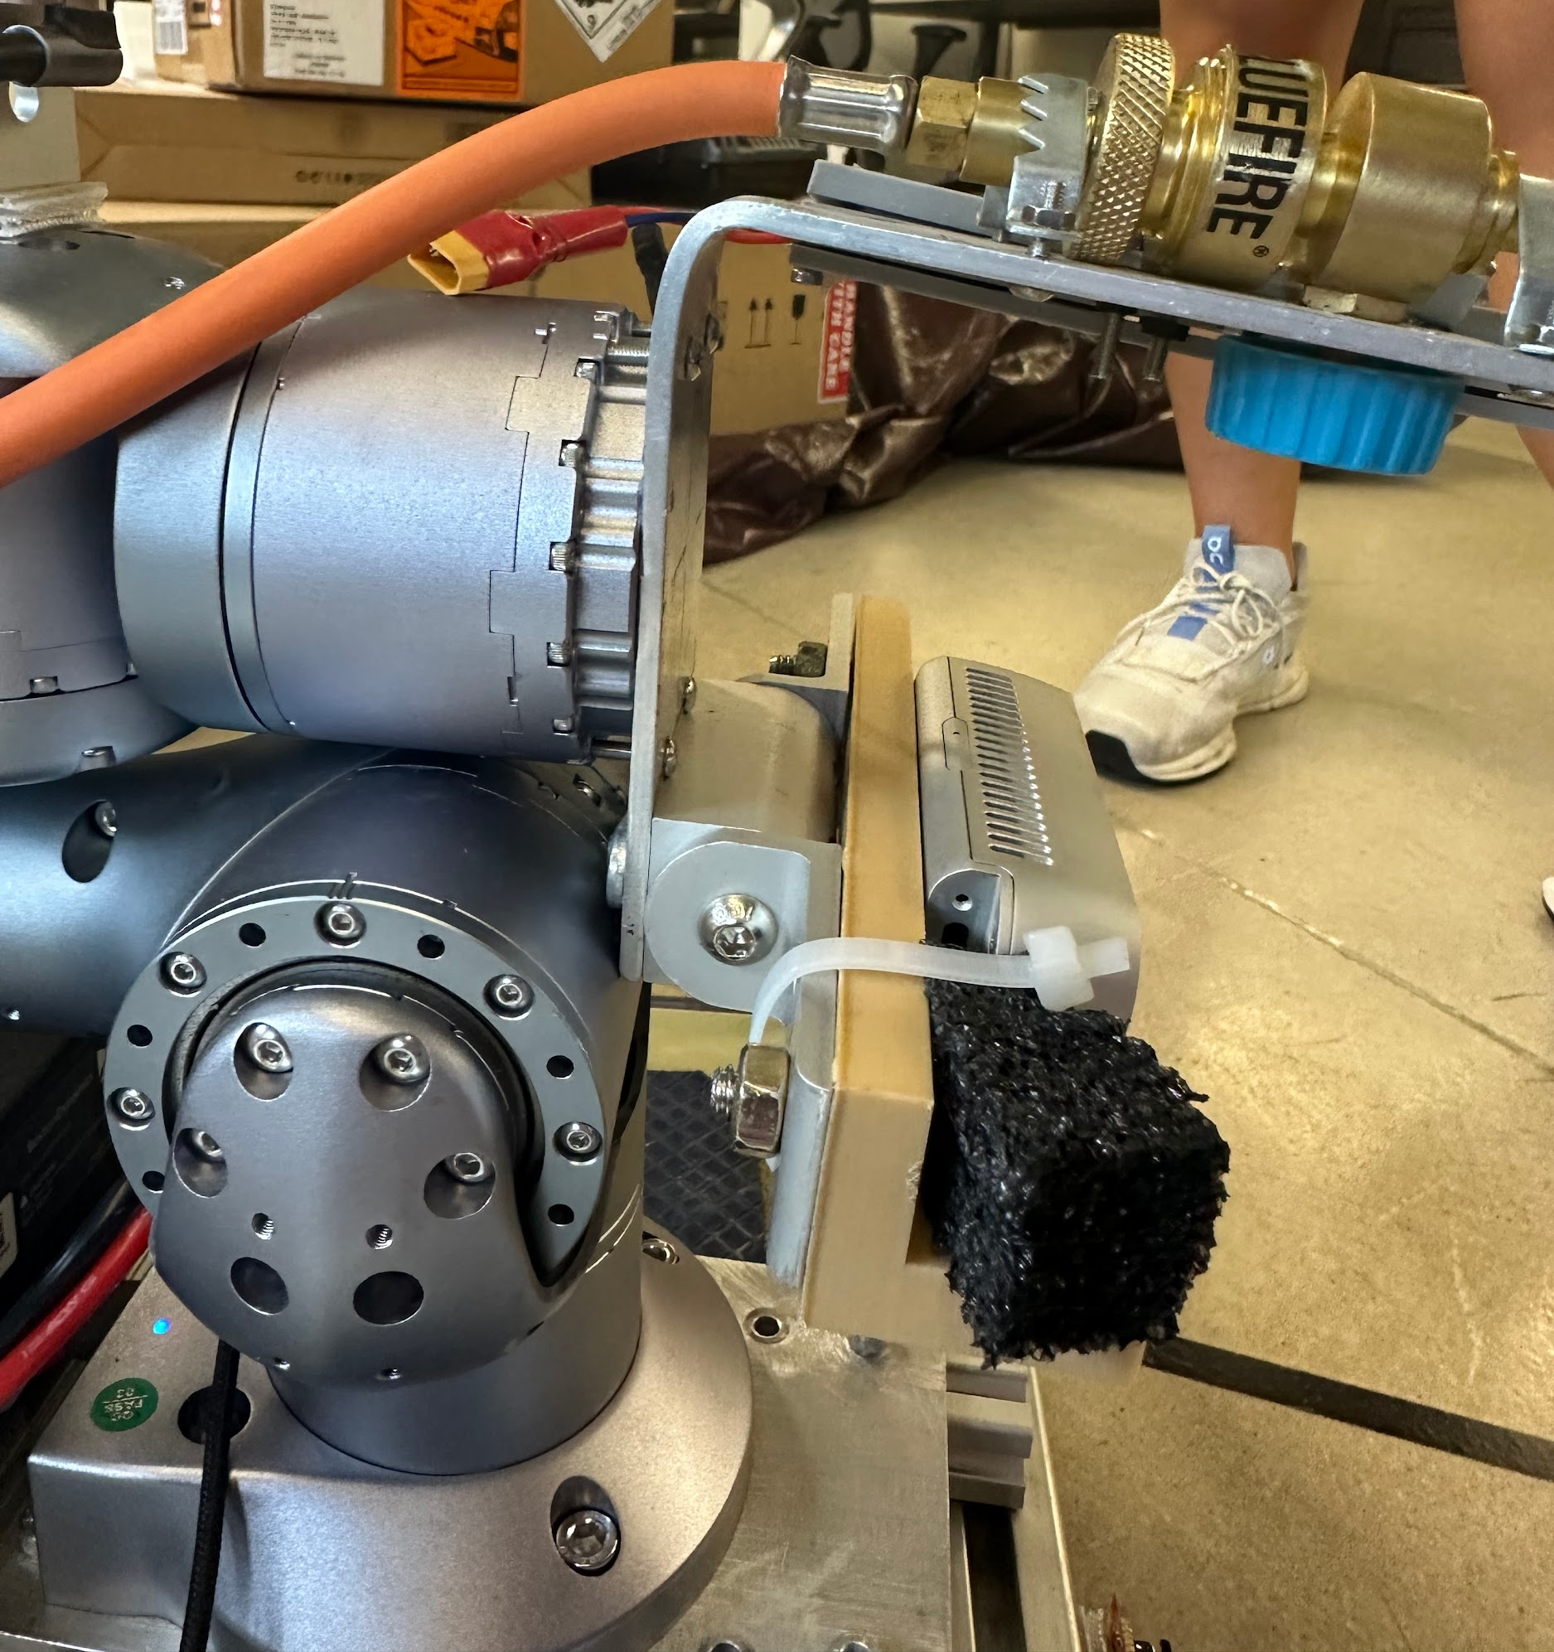
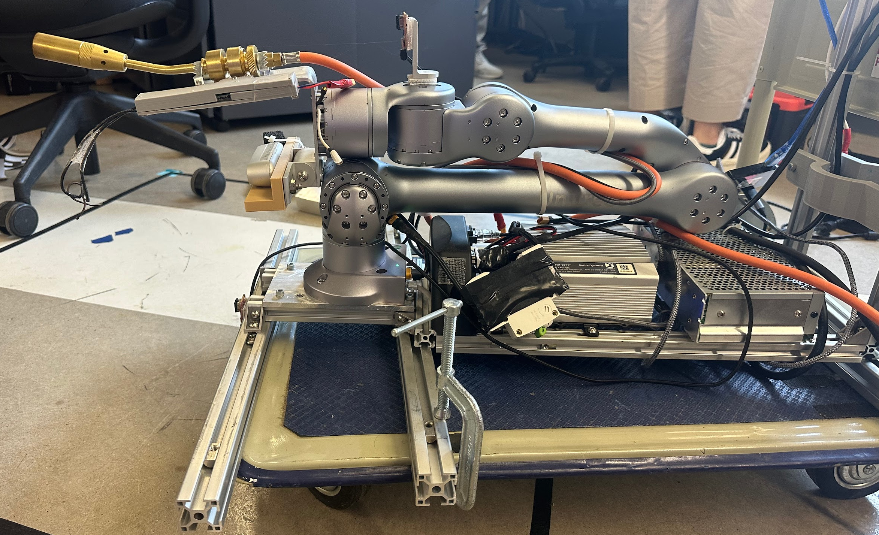
PhD Students Research Project
Met with Shuangyu Xie for live demo of Spot robot + robotic arm
Commercial robotic arm bought from Unitree
DC converter converts power to a usable voltage for arm
Arm is attached through a railing system
Robot used for agriculture weed control

Slide 5
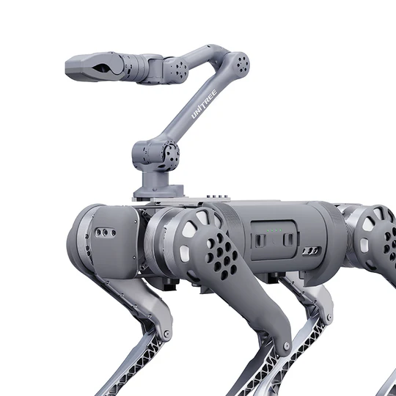
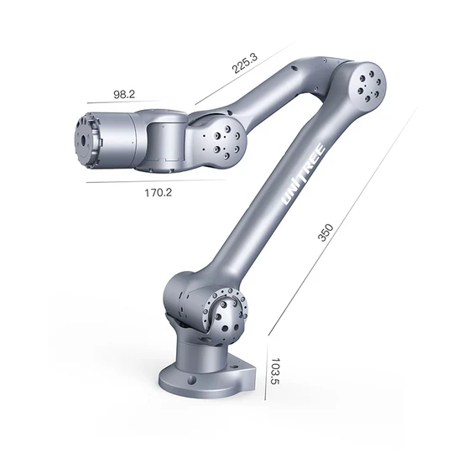
1st 6 - DOF Arm
Unitree Z1 arm
$15,999.00 USD
https://shop.unitree.com/products/unitree-z1
Payload ~ 2 kg

Slide 6
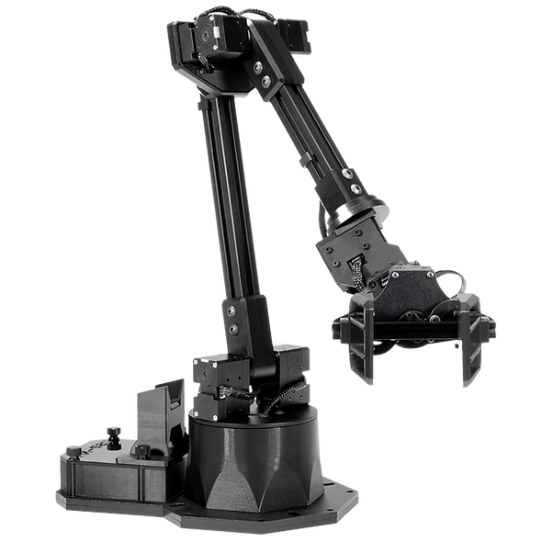
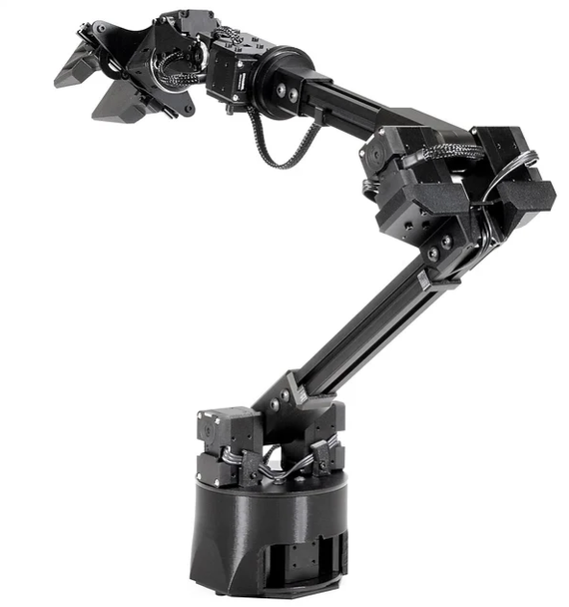
2nd 6 - DOF Arm
WidowX 250 S
$3,549.95
Payload ~ 250 g
https://www.trossenrobotics.com/widowx-250
Mobile ALOHA: Learning Bimanual Mobile Manipulation with Low-Cost Whole-Body Teleoperation

Slide 7
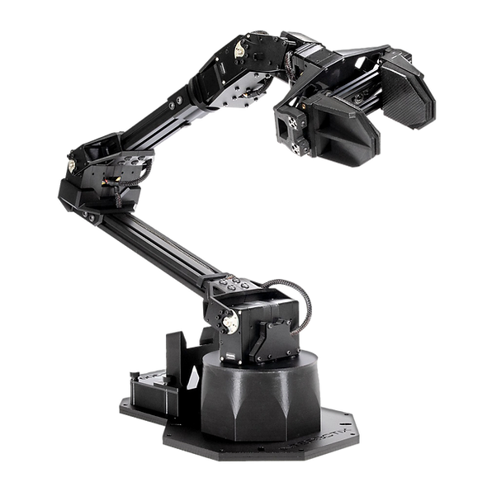
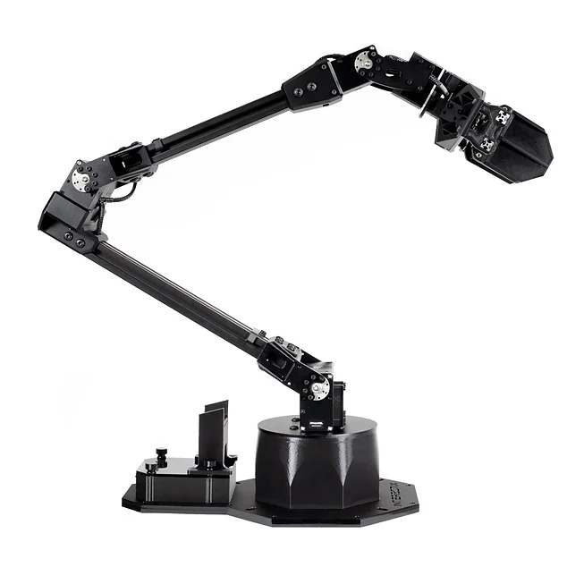
3rd 6 - DOF Arm
ViperX 300 S
$6,129.95
Payload ~ 750 g
https://www.trossenrobotics.com/viperx-300
Mobile ALOHA: Learning Bimanual Mobile Manipulation with Low-Cost Whole-Body Teleoperation

Slide 8
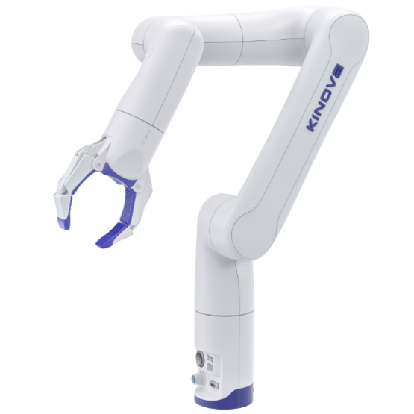
3rd 6 - DOF Arm
Kinova Gen3 lite
$13,500.00 USD
Payload ~ 0.5 kg
https://vention.io/parts/kinova-gen3-lite-6-axis-robot-arm-with-gripper-2084

Slide 9
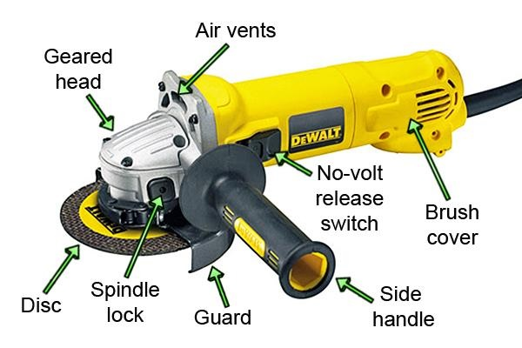
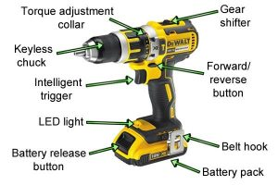
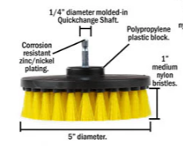
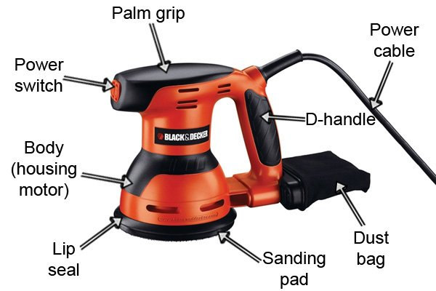
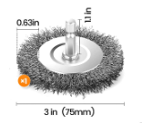
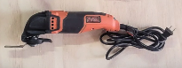
Power Tool Attachments

Slide 10
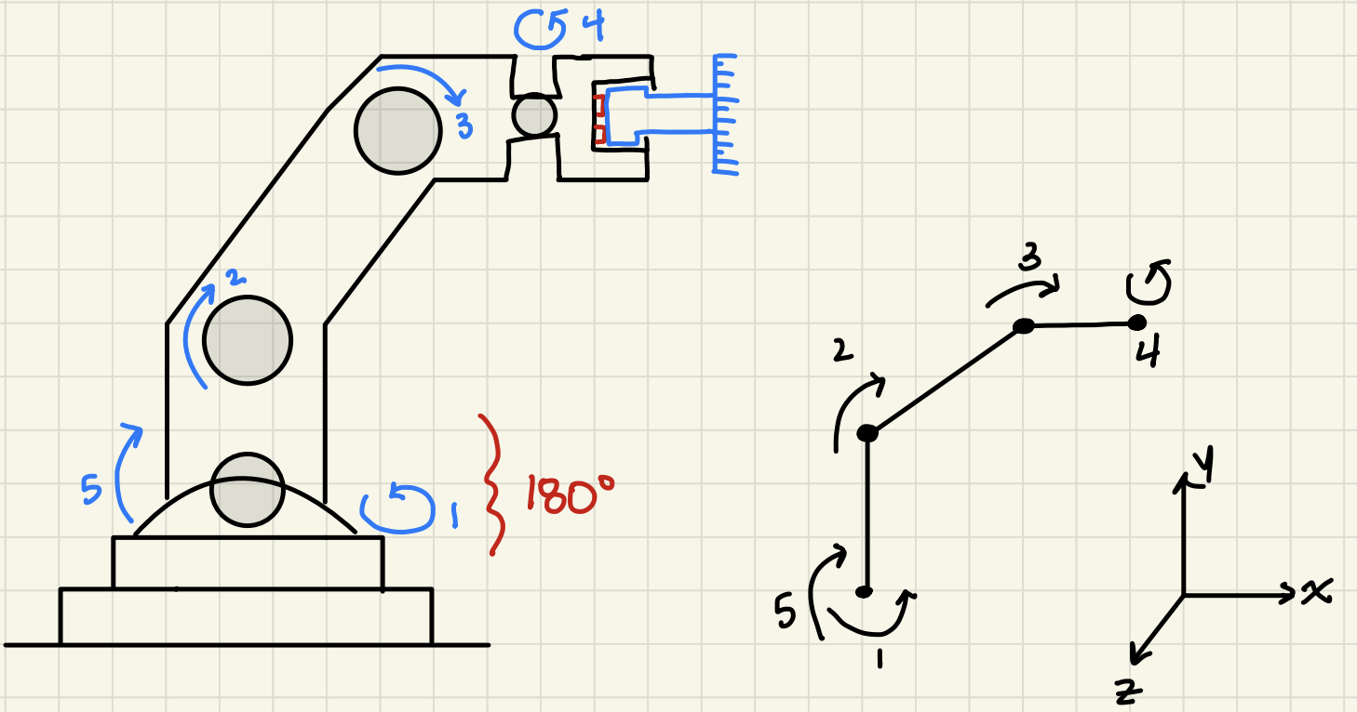
Possible Robot Designs

Slide 11
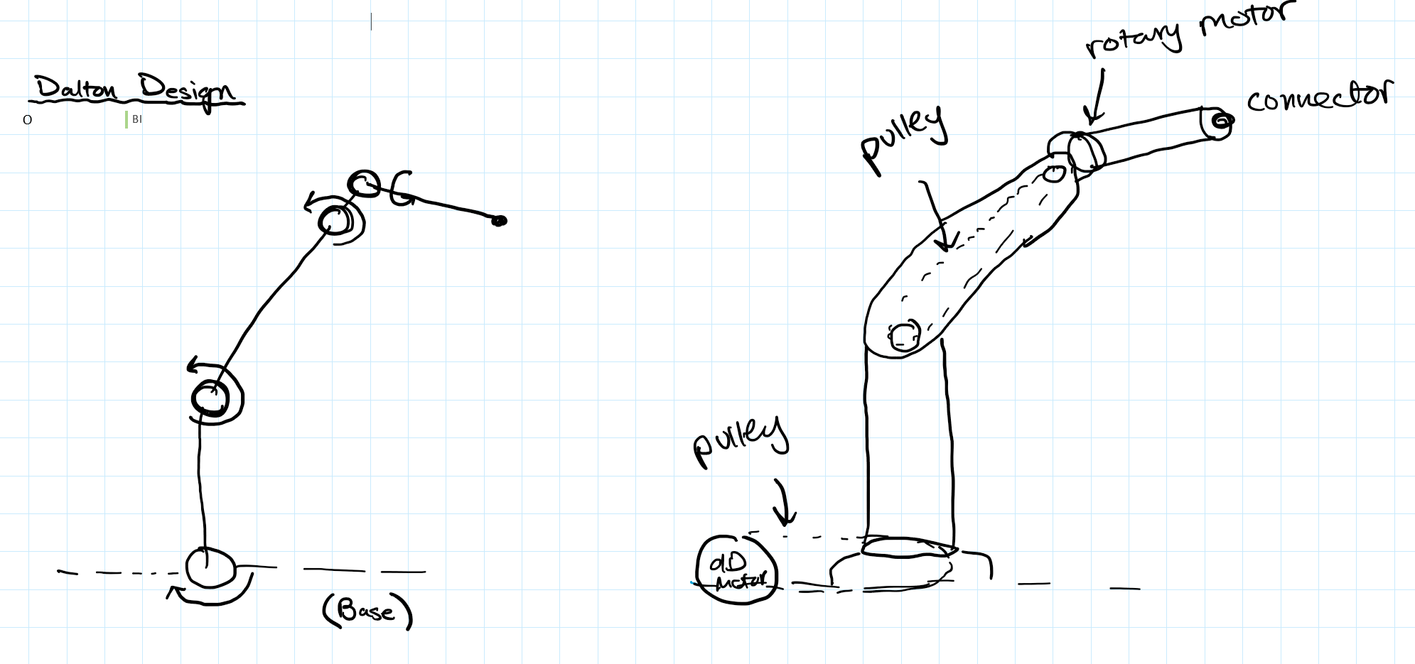
Possible Robot Designs

Slide 12
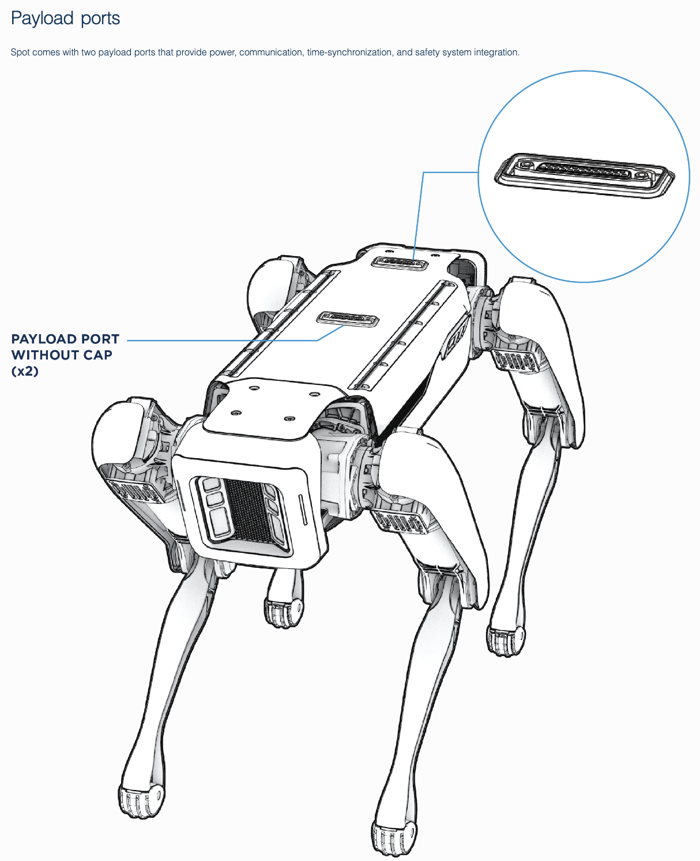
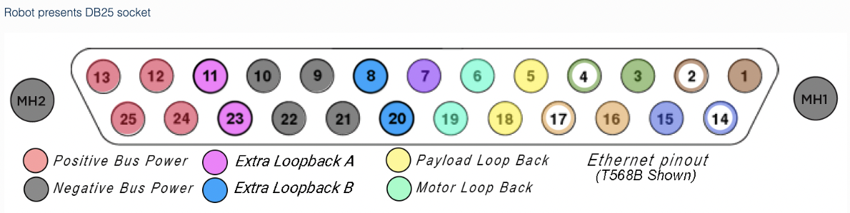
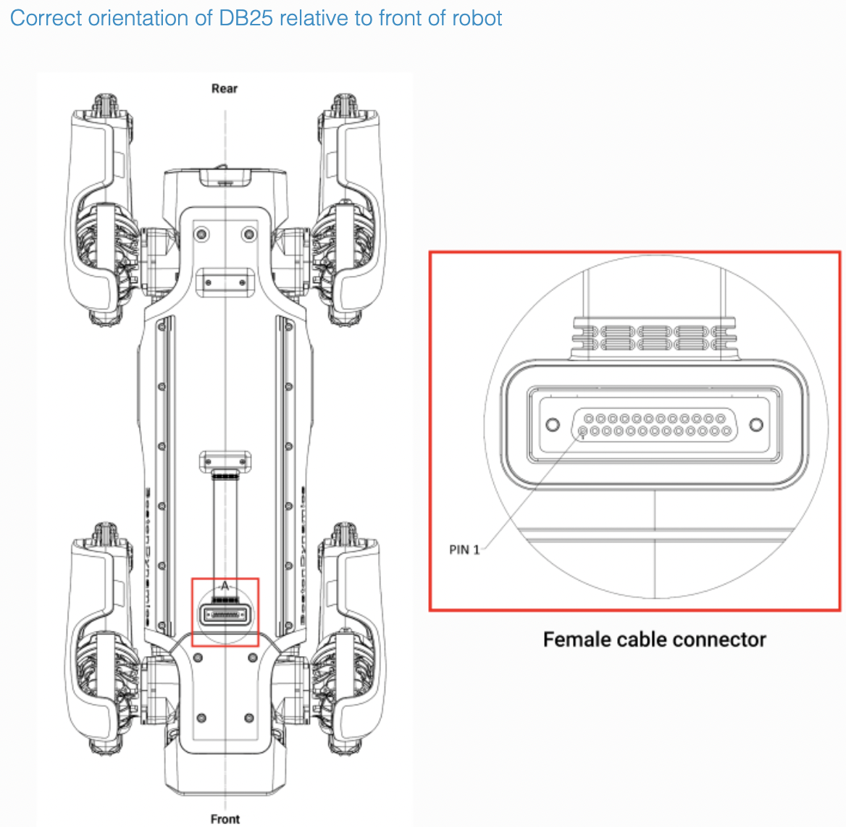
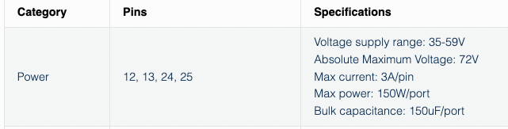
Electrical Components
Electrical Interface Female Payload Ports

Slide 13
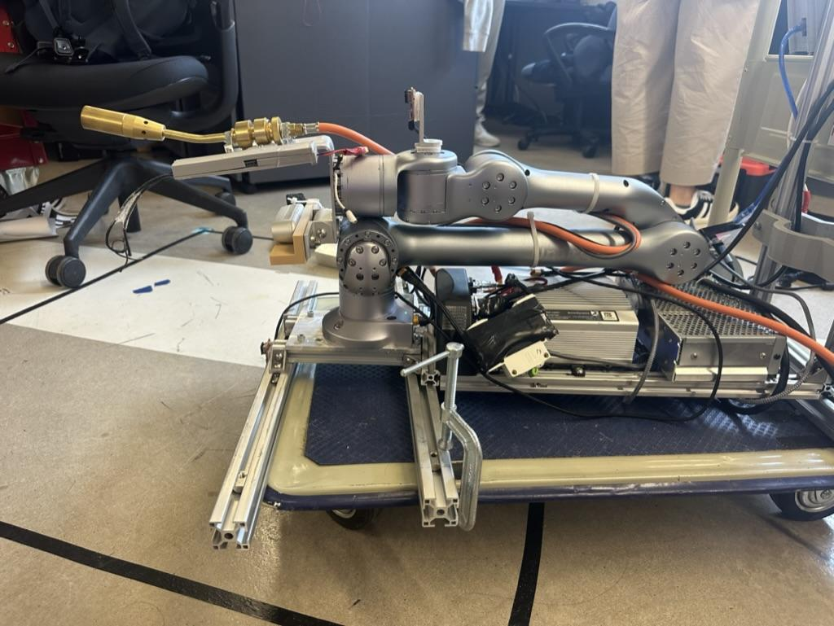
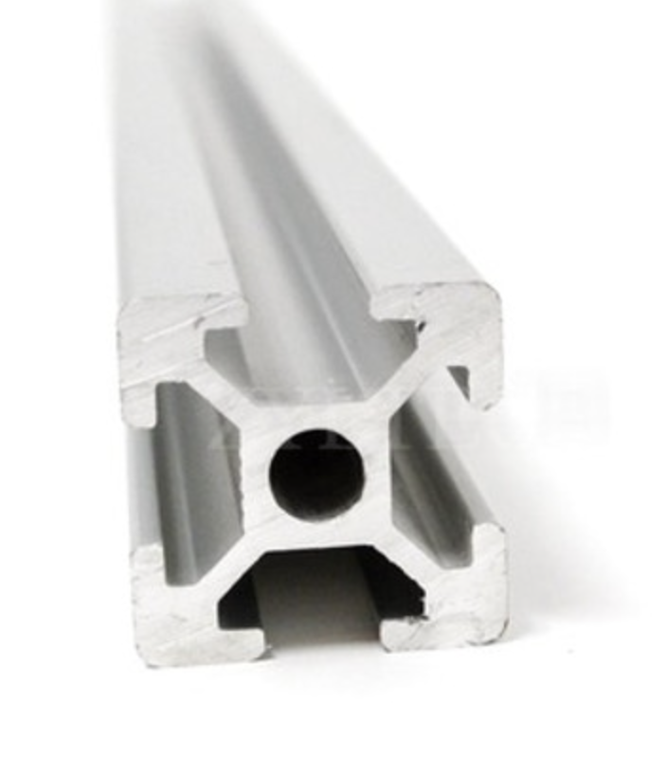
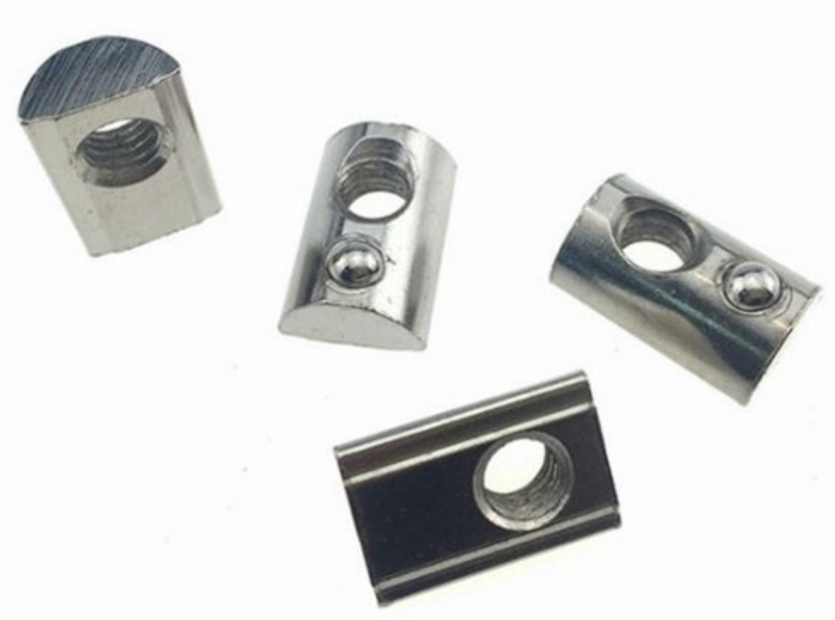
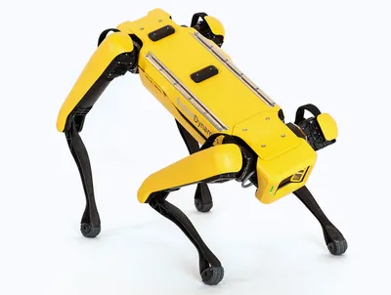
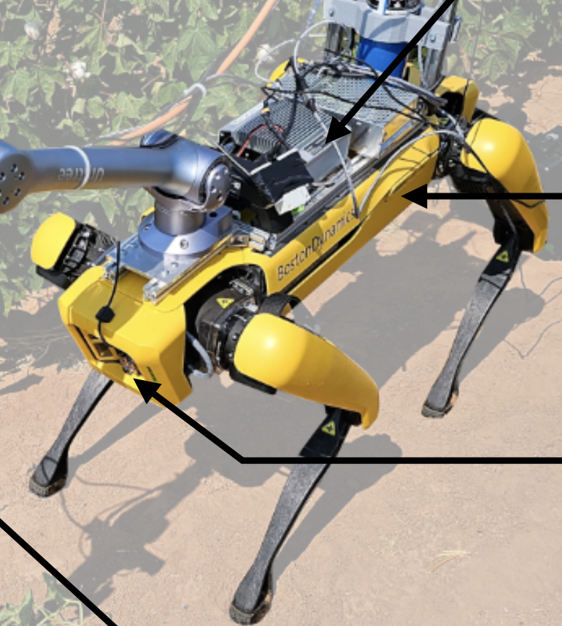
Railing System Design
Railing System
Using the Flamethrower layout as a reference
T-slot Aluminum Extrusion
T-nuts to secure
Use concept generation to begin choosing the best railing system design and layout

Slide 14
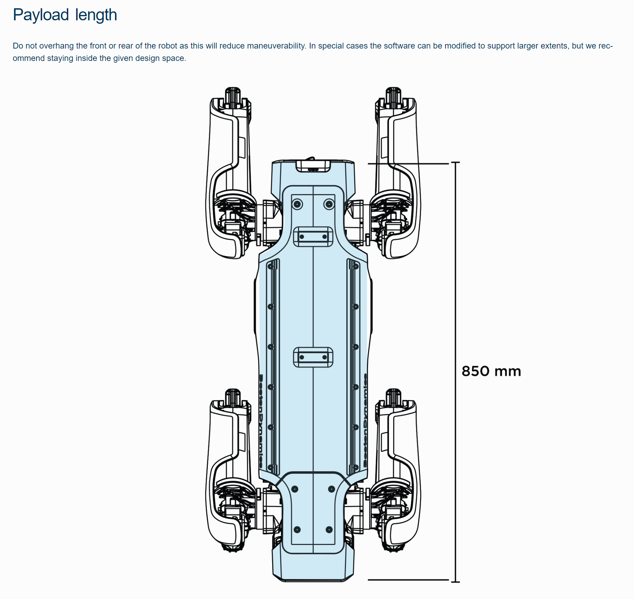
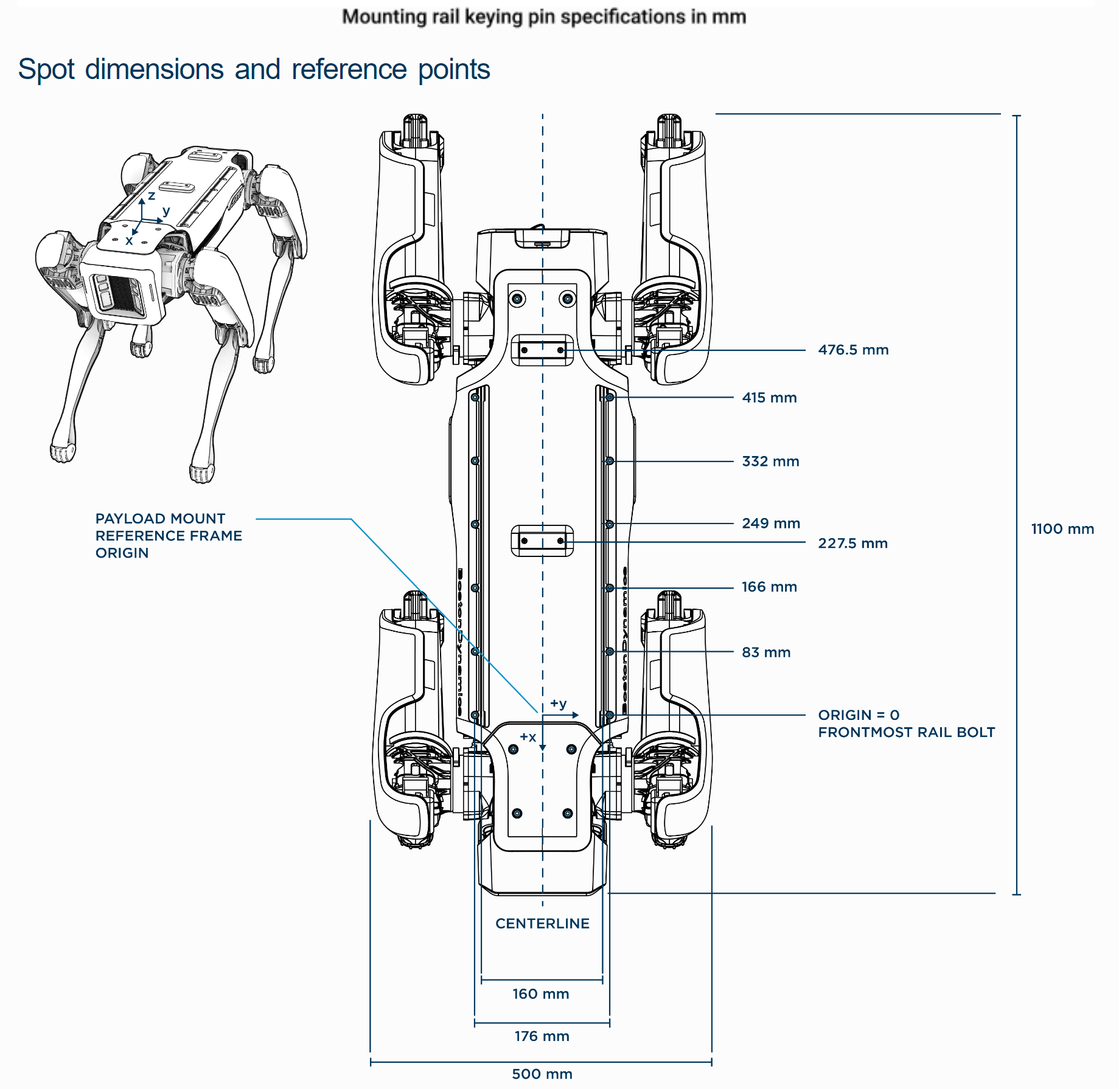
Static Analysis Dimensions
Arm base here

Slide 15
Static Analysis
Goal: Perform static analysis to determine maximum weight on end of arm
Results:
Used Specs and GrabCAD of Spot robot to determine distances
Drew diagram of forces
Created Code to calculate forces incase parameters change
Obtained values of F1= 184, F2= -168, Mt = -29.51
This is wrong because of the negative signs

Slide 16
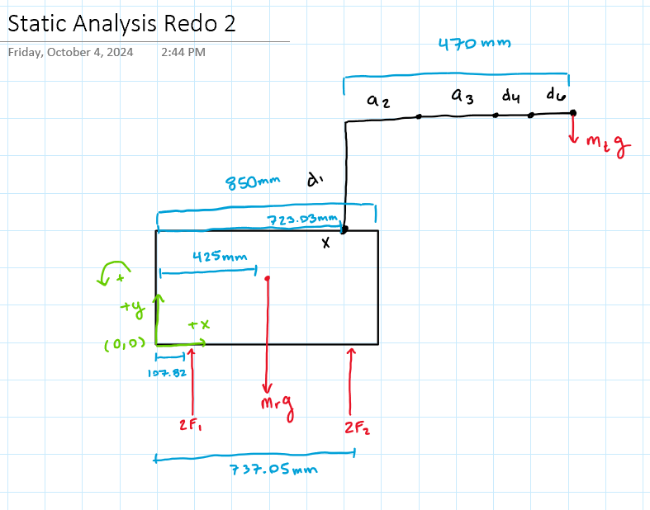
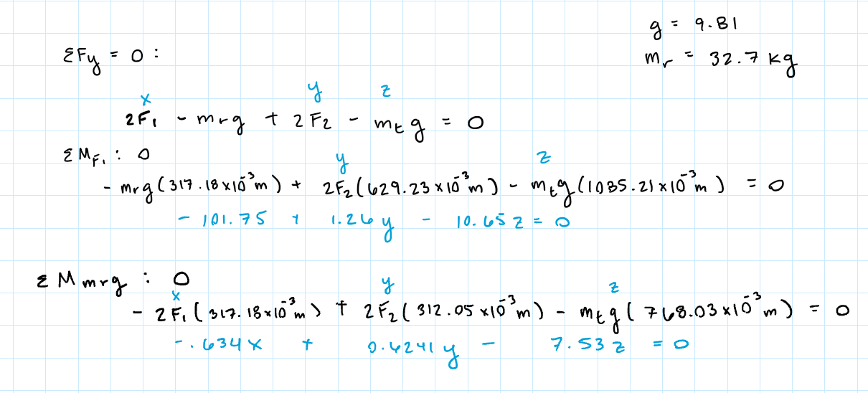
Static Analysis

Slide 17
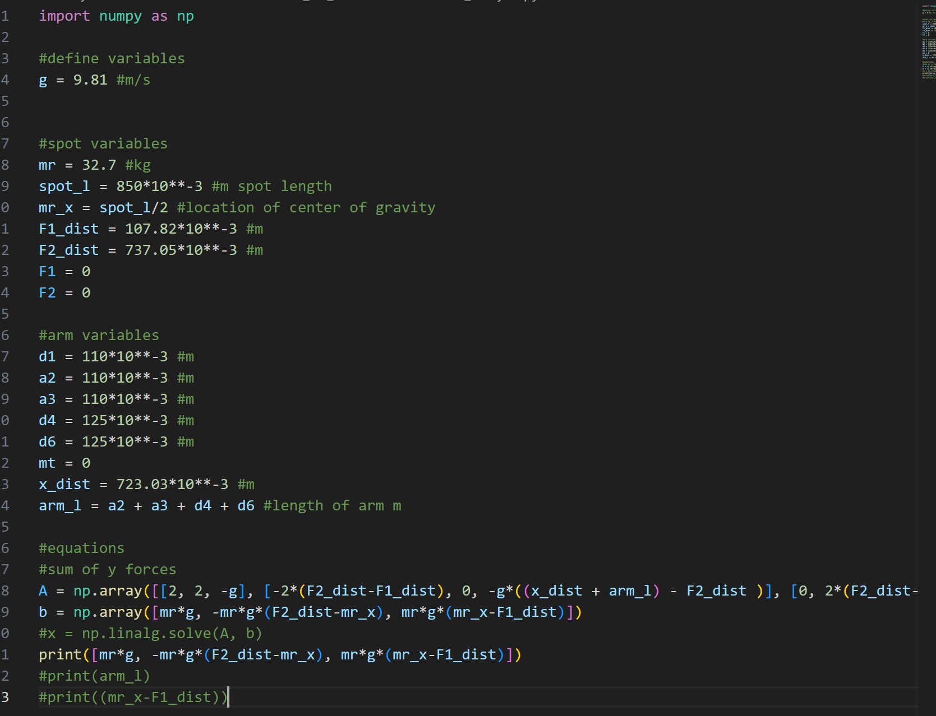
Static Analysis Code

Slide 18
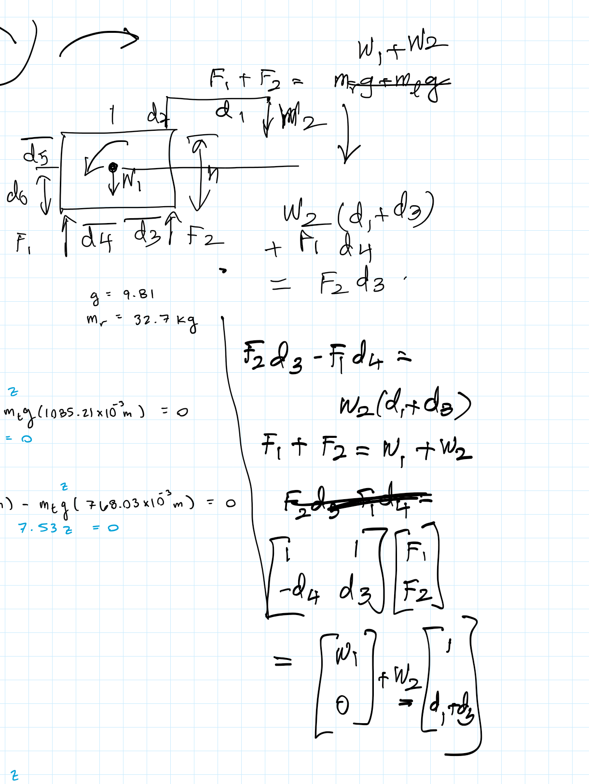
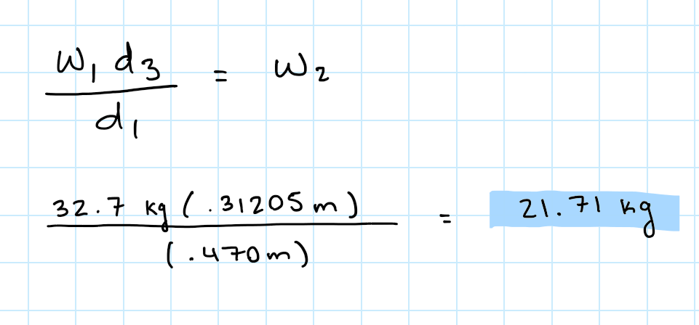
Maximum Weight
Calculated maximum weight that will tip the dog assuming a 470mm long arm is 21.71 kg

Slide 19
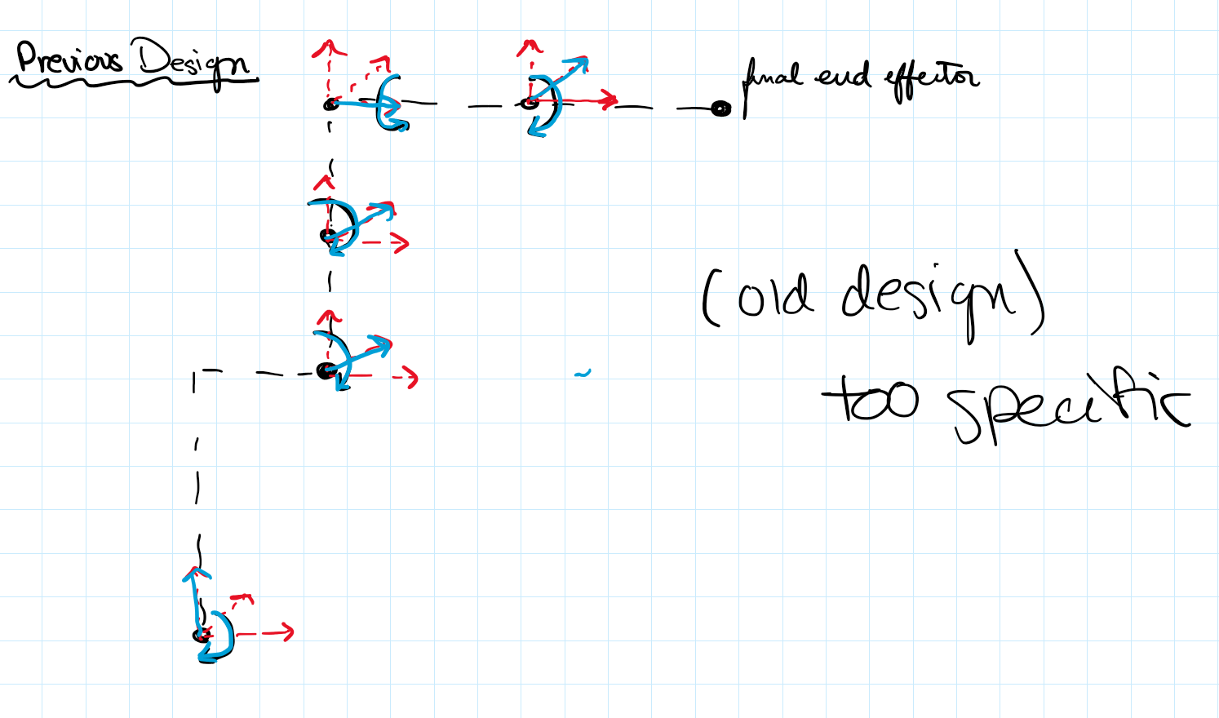
First iteration 6 DOF design

Slide 20
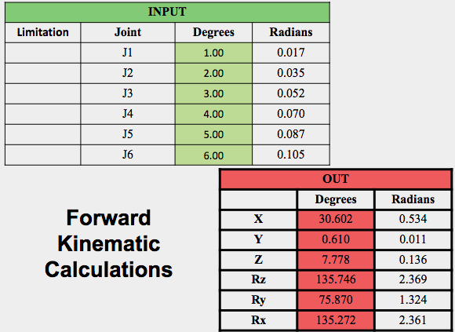
Inverse Kinematic Analysis
Input
 | Degrees | Radians
X | 30.602 | 0.534
Y | 0.610 | 0.011
Z | 7.778 | 0.136
Rz | 135.746 | 0.000
Ry | 75.870 | 0.000
Rx | 135.272 | 0.000
Inverse Kinematic Calculations
Inverse Kinematics Calculations:
Completed and verified with Forward Kinematics.
We can now adjust the design to optimize the solution workspace.
Key Design Decisions:
Link Lengths
Joint Types and Arrangements
Output
Limitation | Joint | Degrees | Radians
 | J1 | 1.00 | 0.0174533
 | J2 | 2.00 | 0.0349066
 | J3 | 3.00 | 0.0523599
 | J4 | 4.00 | 0.0698132
 | J5 | 5.00 | 0.0872665
 | J6 | 6.00 | 0.1047198

Slide 21
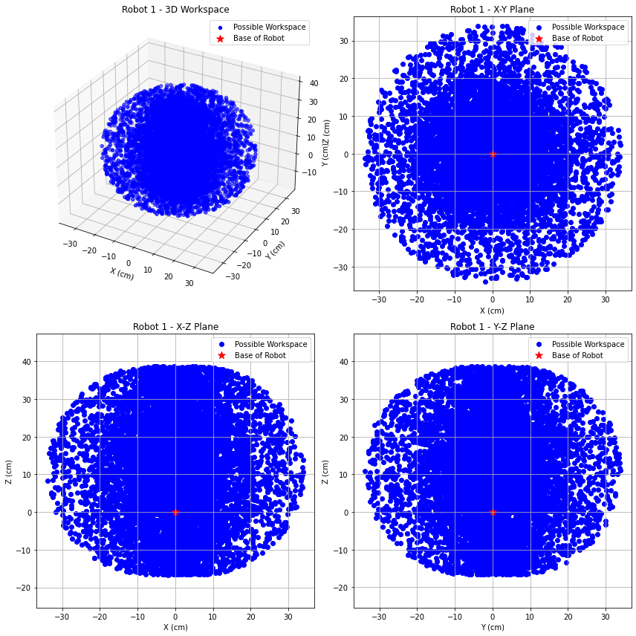
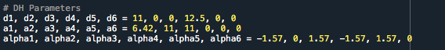
Solution Space Calculations
Solution Space Calculations:
Performed using Monte Carlo random sampling of joint angles within the range (-π, π).
Forward Kinematics
Robot 1:
Dimensioning based off of our sizing for human arm
Does Not meet the 2 feet radius workspace desired by LANL
Adjustments need to be made to dimensioning

Slide 22
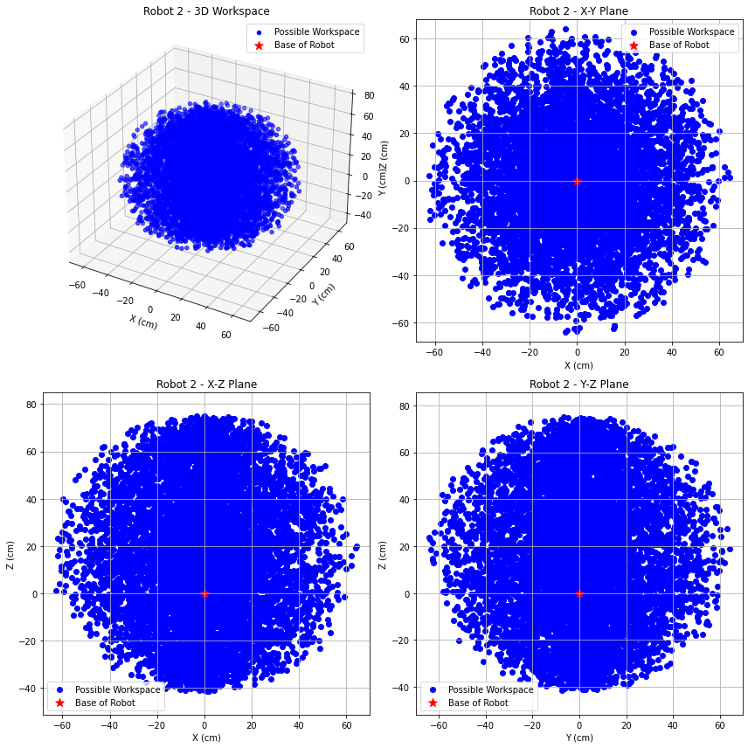
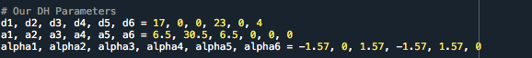
Solution Space Calculations
Robot 2:
Dimensioned based on human arm proportions, with adjustments.
Achieves the 2-foot radius workspace required by LANL.
Scheduled for presentation to David on Friday for validation.
All values are easily adjustable and can be modified as needed.

Slide 23

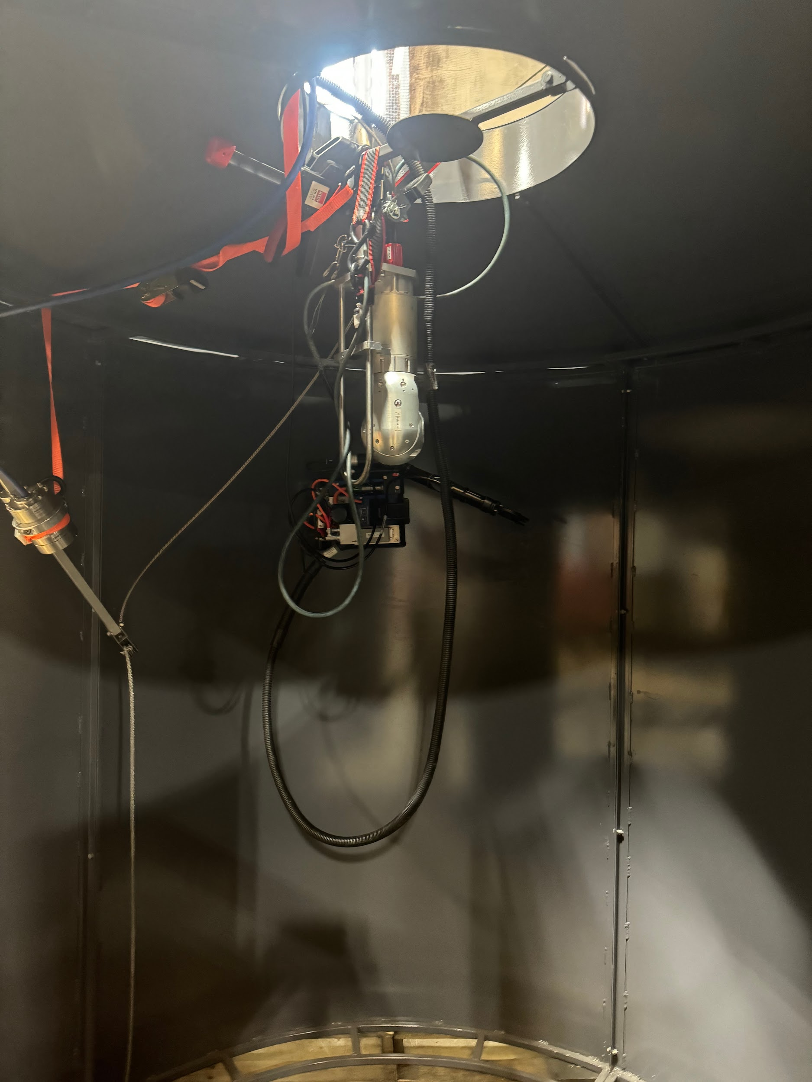
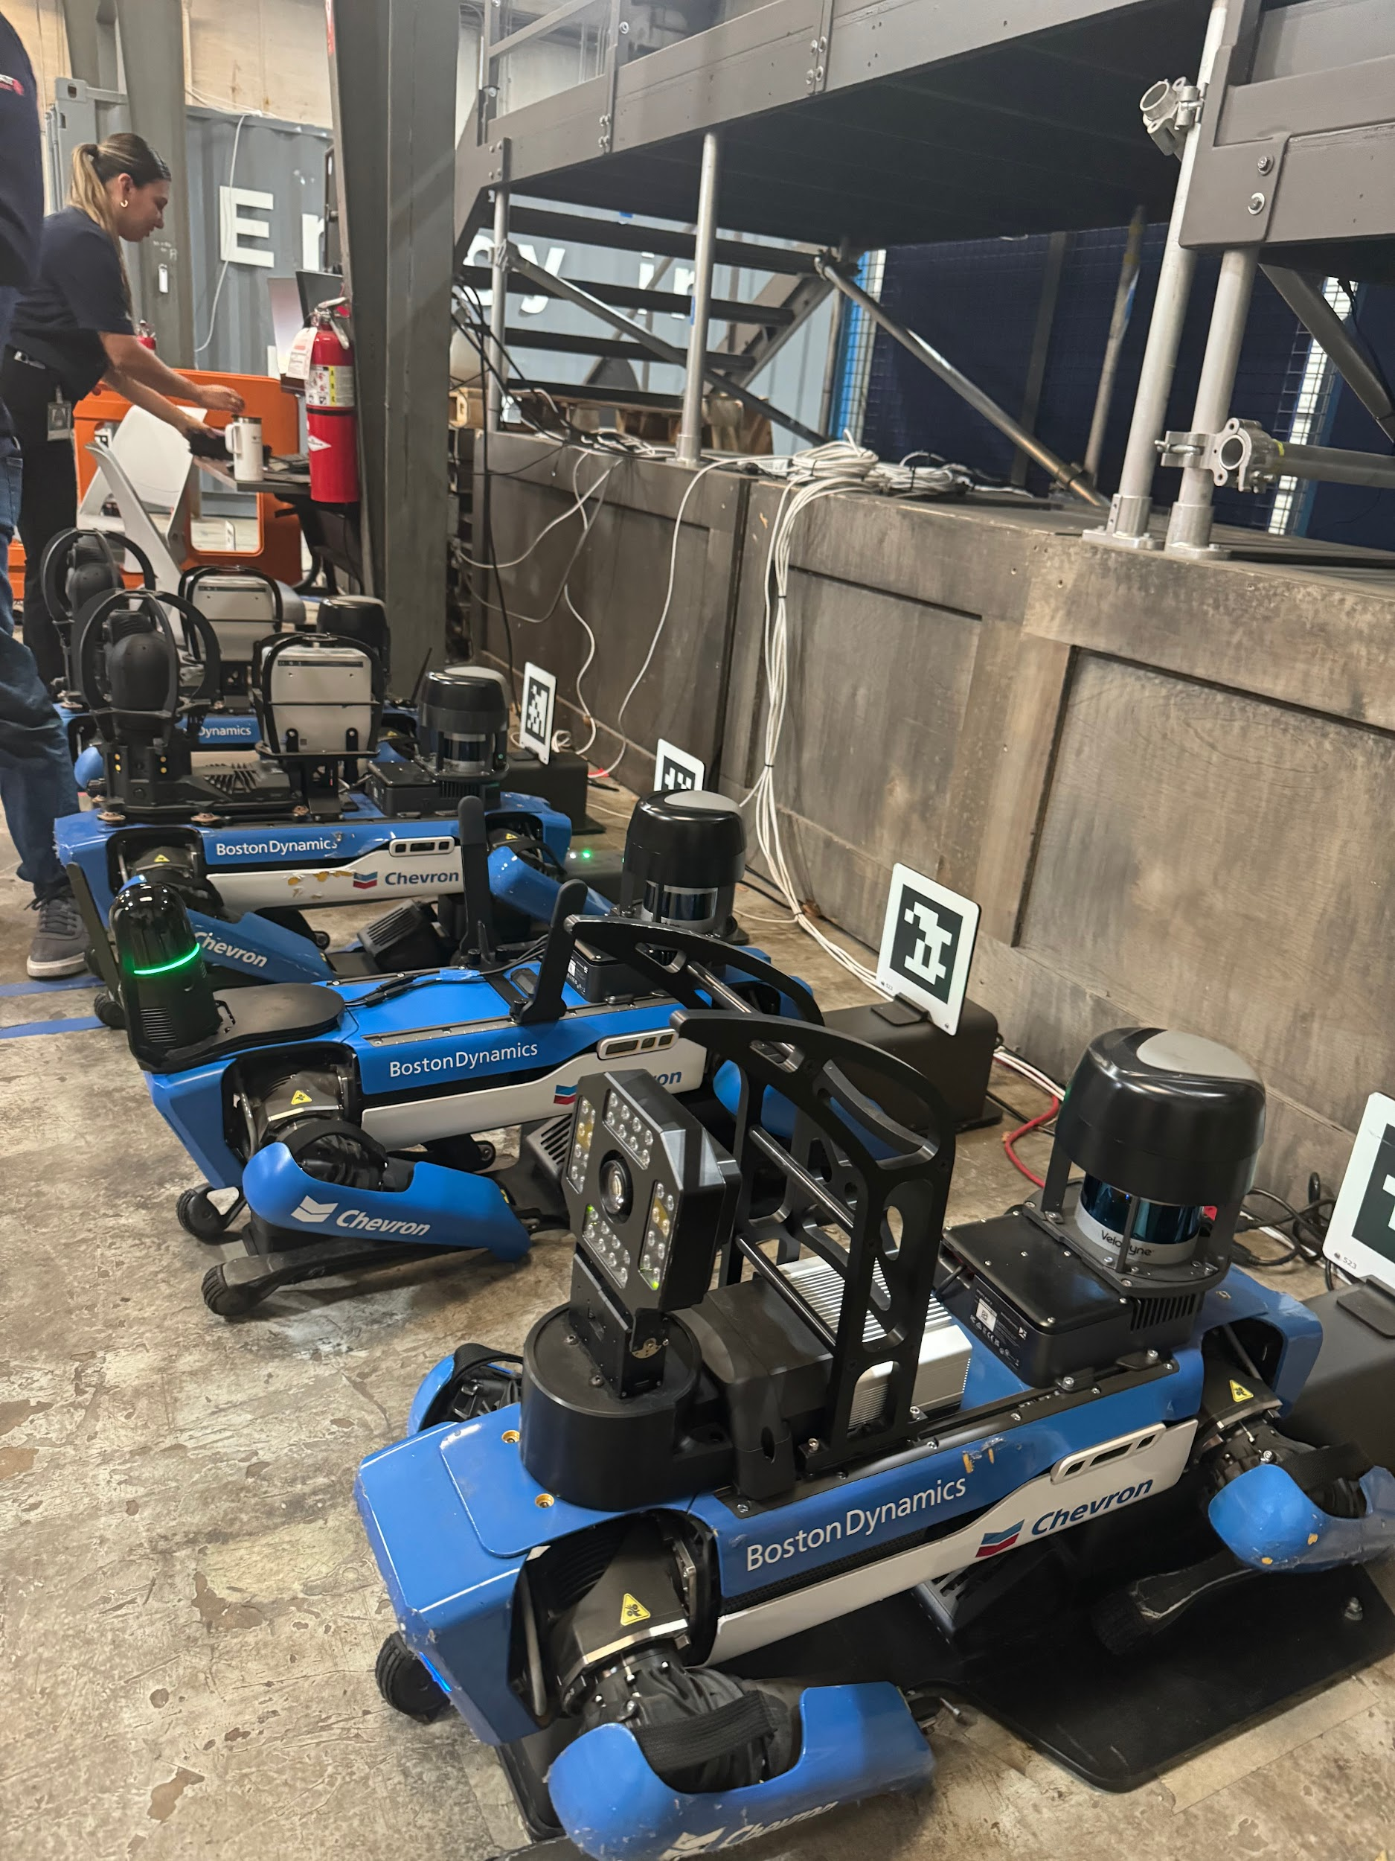
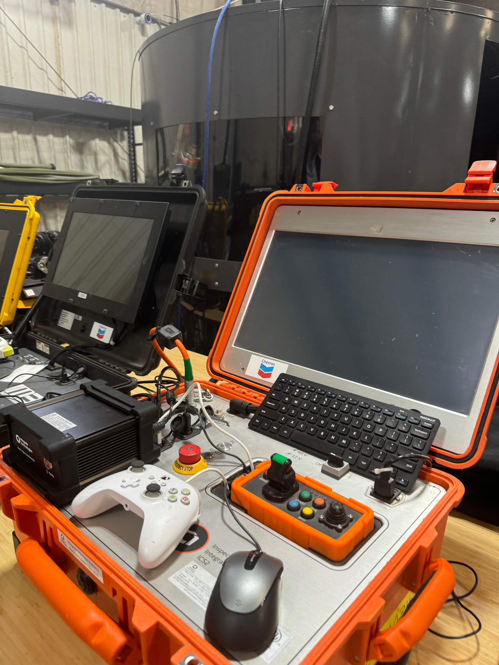
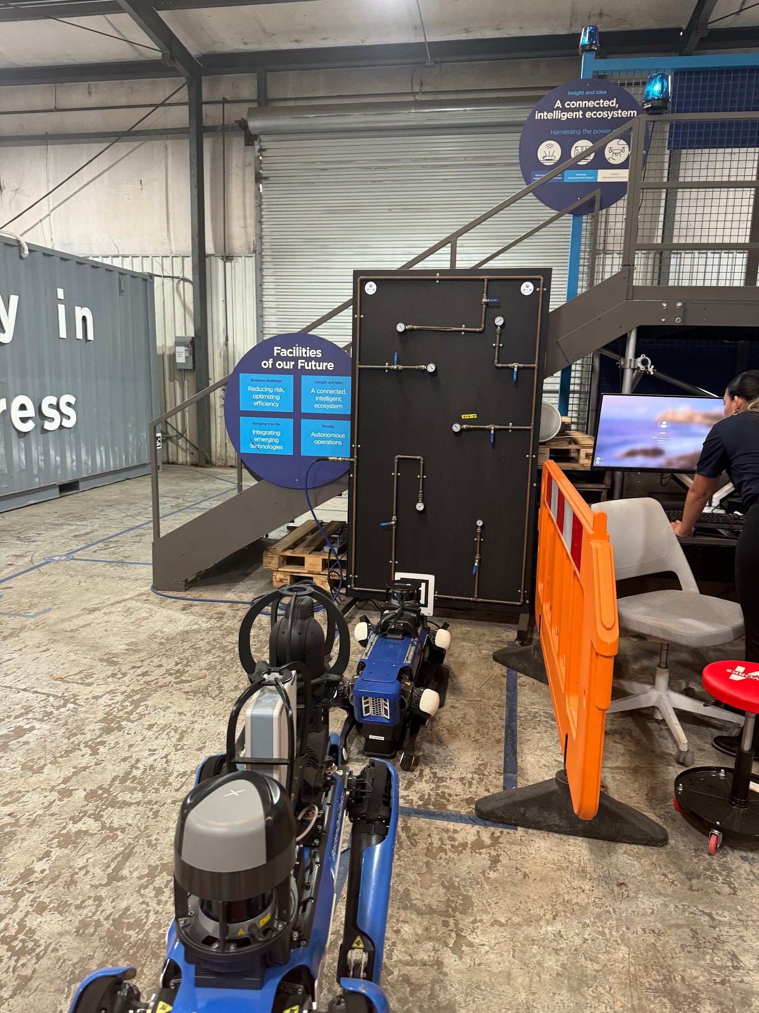
Site Visits
Tour on 10/8 - Met with Betsy Perales (Robotics Operations Engineer)

Slide 24

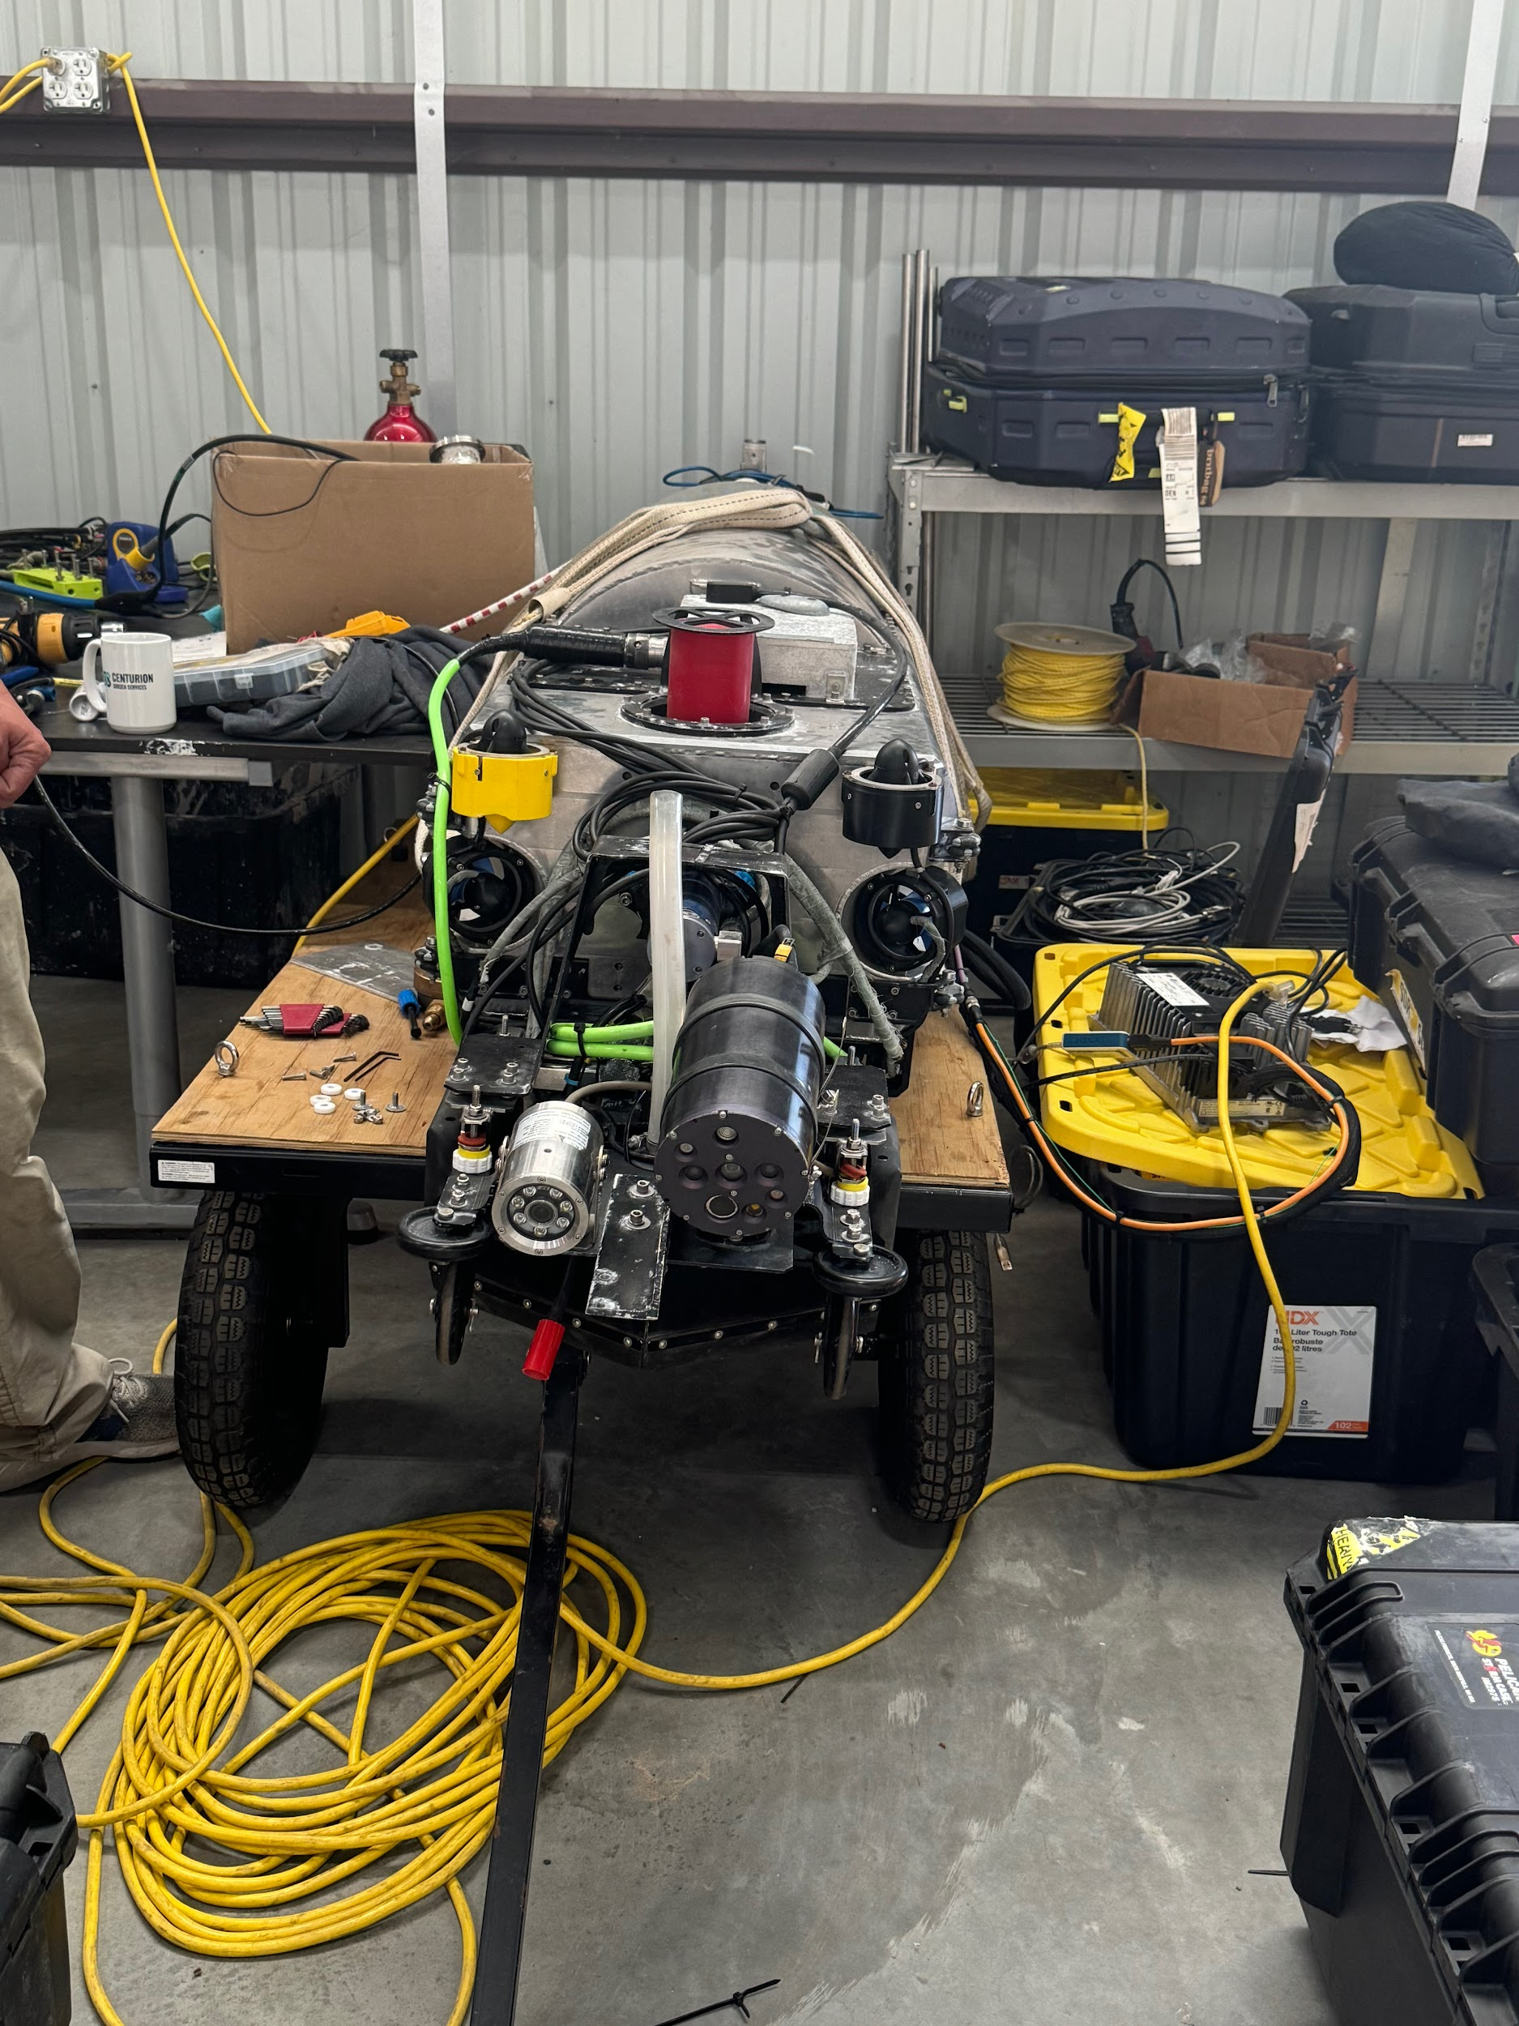
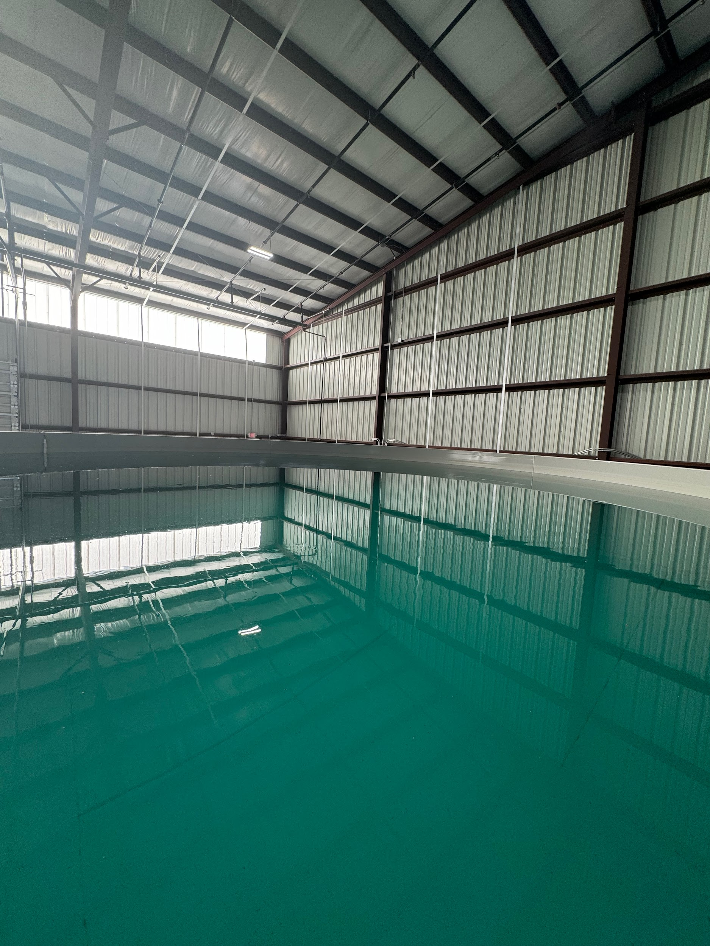
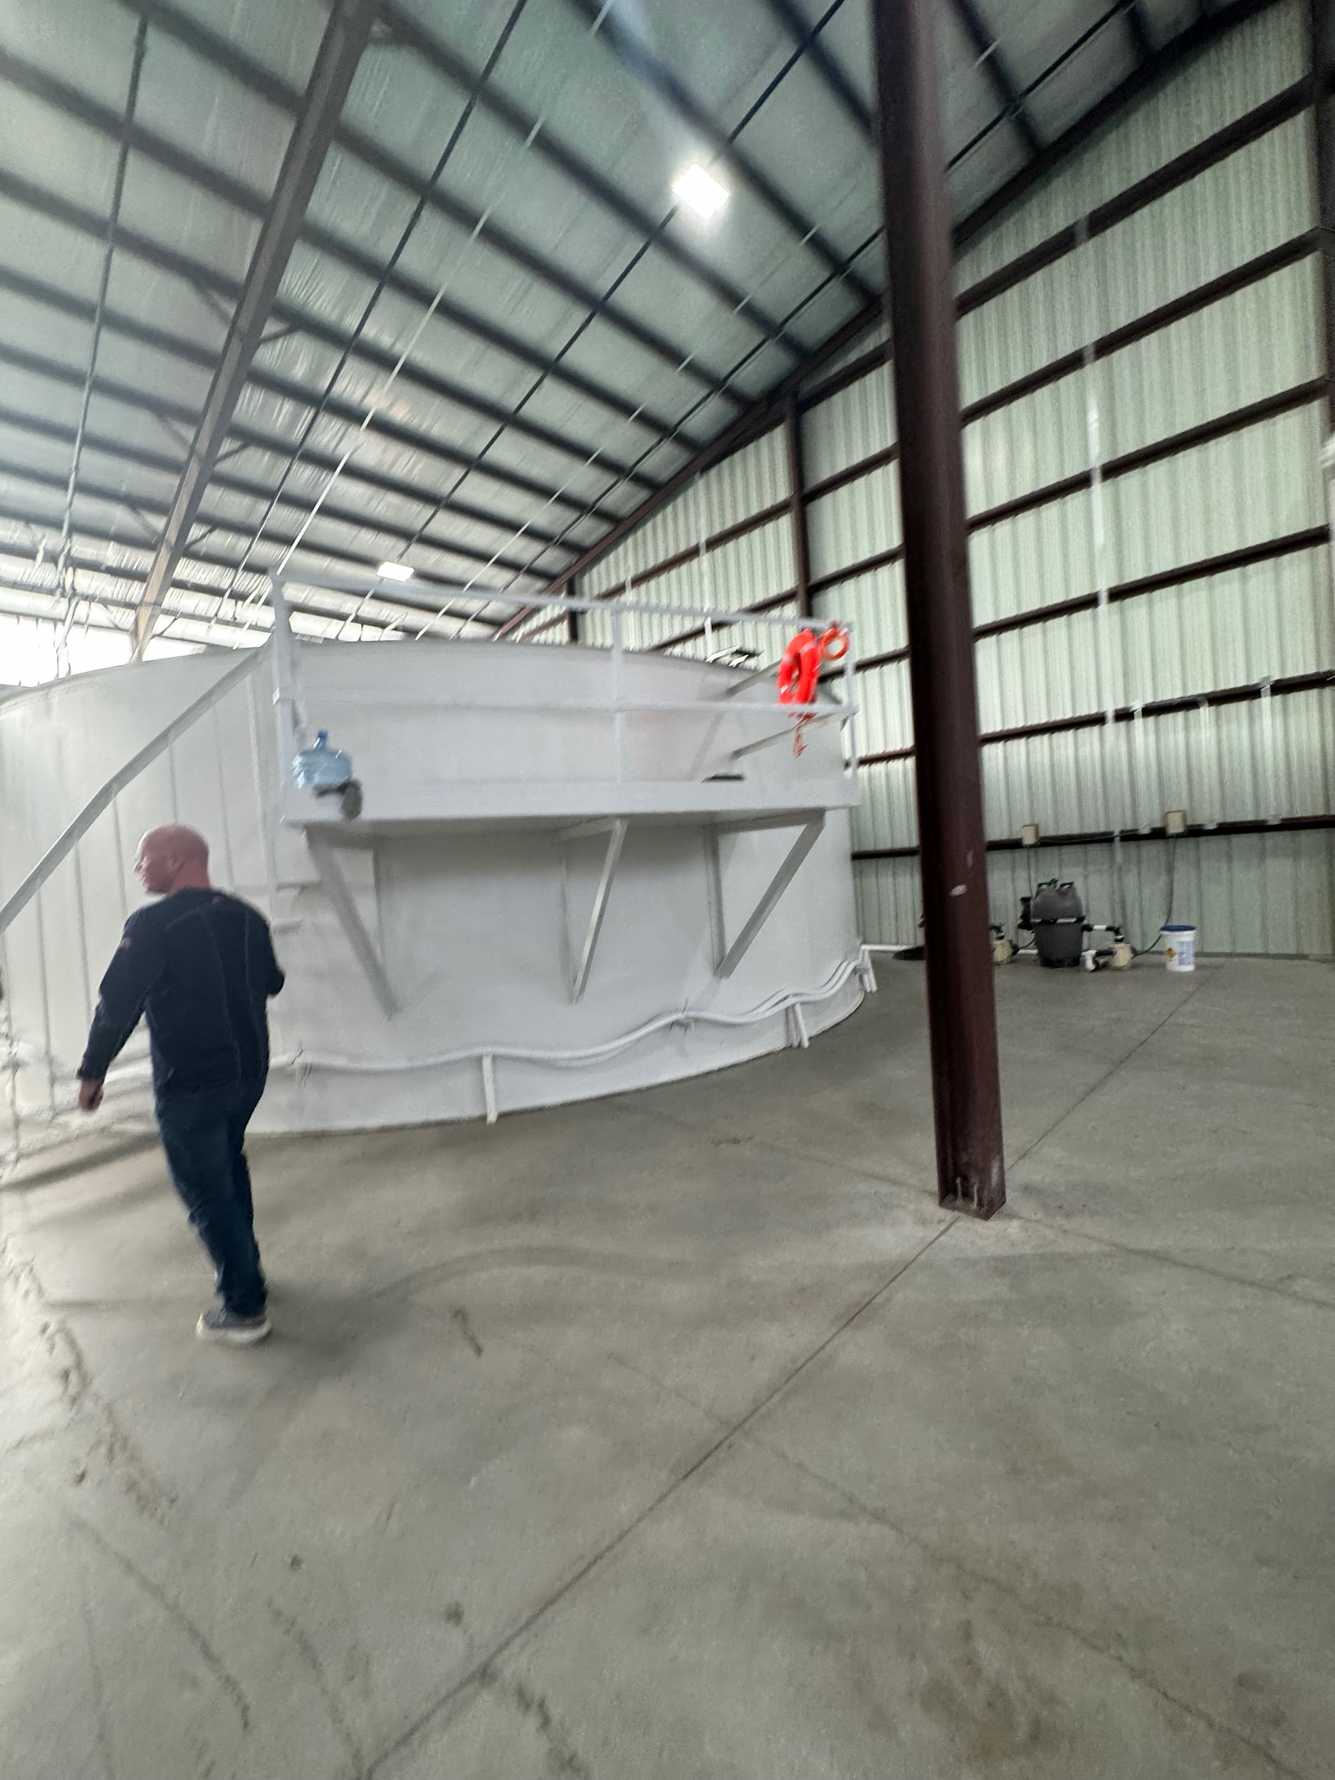



Site Visits
Met with Damien Goodyear - Director of Operations (10/8)
Customers

Slide 25
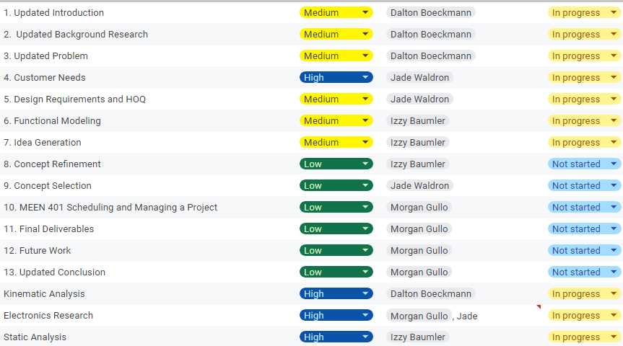
Schedule

